Slide 1

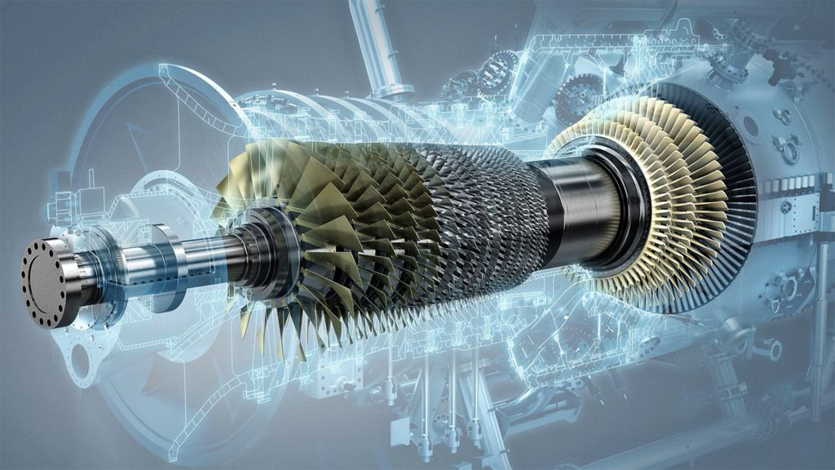

GAS TURBINE - Predicting Turbine Energy Yield (TEY)
z
PRESENTED BY
YASHWANT DHURI
git-hub:- github.com/Yash-1409
linkedin:- linkedin.com/in/yashwant-dhuri-60400b194

Slide 2


Yashwant Dhuri Aspiring Data Scientist
Skills
Contact
Education
Python
Pune, Maharashtra
Mechanical Engineering (2016-2020)
Finolex college of Engineering, RTN.
PG program in Data Analyst and MachineLearning (2022),
Imarticus Learning,Pune
Statistics
Machine Learning
SQL
9881457590
Pandas
yashwantdhur14@gmail.com
Excel
Work Experience
Languages
Intern,
Fabri-Tek Equipments Pvt.Ltd,Pune (june,2019 to july,2019)
Work with quality control management team to understand the tools like quality planning, quality control, quality assurance and quality improvement
English
Marathi
Hindi

Slide 3
PROBLEM STATEMENT
Is there a relationship between the process, ambient variables & Turbine Energy Yield (TEY)
Predicting Turbine Energy Yield (TEY) using the process, ambient variables as features

Slide 4
WORK FLOW
Data Collection and
Understanding
Data Wrangling & Feature Engineering
EDA
Model Selection and Evaluation
Preparation of data for model building.
Conclusions

Slide 5
INTRODUCTION
Instances - 36,733
Features - 11
Measures gathered over one hour , from a gas turbine located in Turkey
Predicting TEY using ambient & process variables as features

Slide 6
ATTRIBUTE INFORMATION
TARGET COLUMN :
TEY: Turbine Energy Yield (MWH)
AMBIENT VARIABLES :
AT: Ambient temperature (C)
AP: Ambient pressure (mbar)
AH: Ambient humidity (%)
EMMISION VARIABLES :
CO: Carbon monoxide (mg/m3)
NOX: Nitrogen oxides (mg/m3)
PROCESS VARIABLES :
AFDP: Air filter difference pressure (mbar)
GTEP: Gas turbine exhaust pressure (mbar)
TIT: Turbine inlet temperature (C)
TAT: Turbine after temperature (C)
CDP: Compressor discharge pressure (mbar)

Slide 7
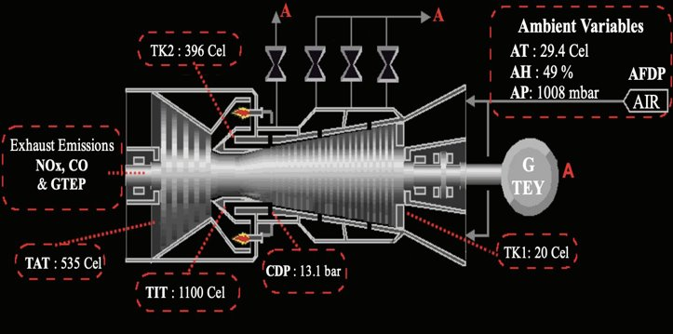
Pic 1. GAS TURBINE LAYOUT
Source : Heysem Kaya, Pinar Tufekci and Erdinc Uzun. 'Predicting CO and NOx
emissions from gas turbines: novel data and a benchmark PEMS',
Turkish Journal of Electrical Engineering & Computer Sciences, vol. 27,
2019, pp. 4783-4796,
Pic 2. WORKING OF A GAS TURBINE
Source : www.giphy.com

Slide 8
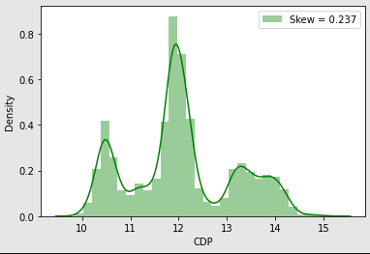
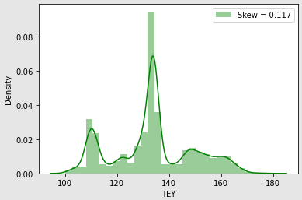
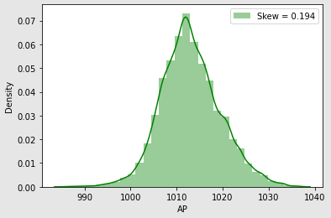
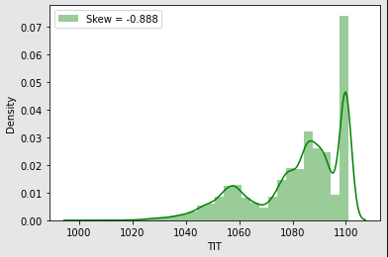
EXPLORATORY DATA ANALYSIS:-Histogram

Slide 9
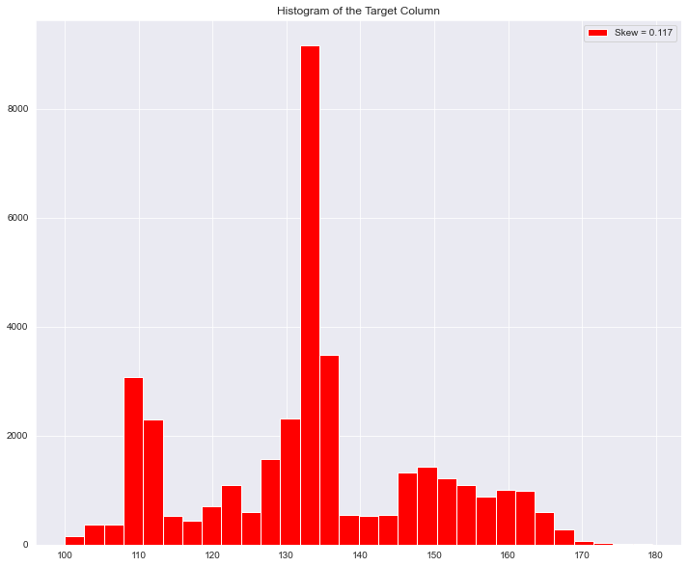
Histogram of trarget Column:-

Slide 10
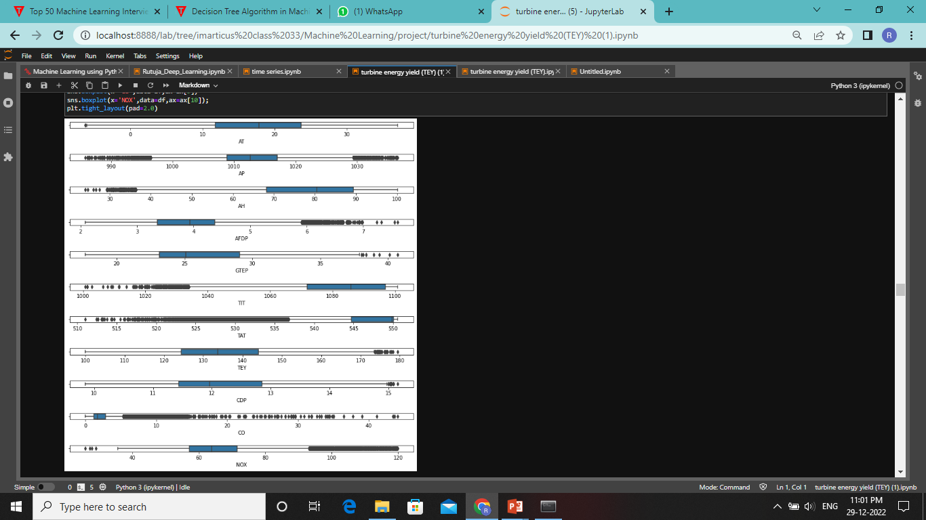
OUTLIERS

Slide 11
UNIVARIATE ANALYSIS
Some of the features are normally distributed
The features AH, CO, TIT and TAT exhibit the highest skew coefficients
Distribution of CO and TIT and TAT seem to contain many outliers
Distplots are used to visualize the skewness of the variables

Slide 12
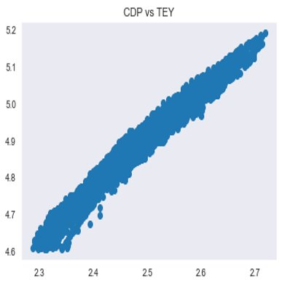
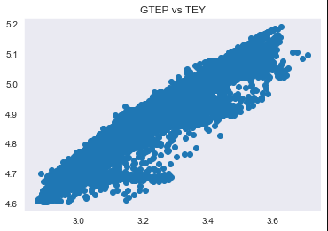

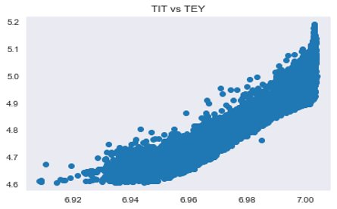
SCATTER PLOT
BIVARIATE ANALYSIS :

Slide 13
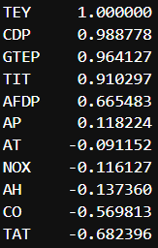
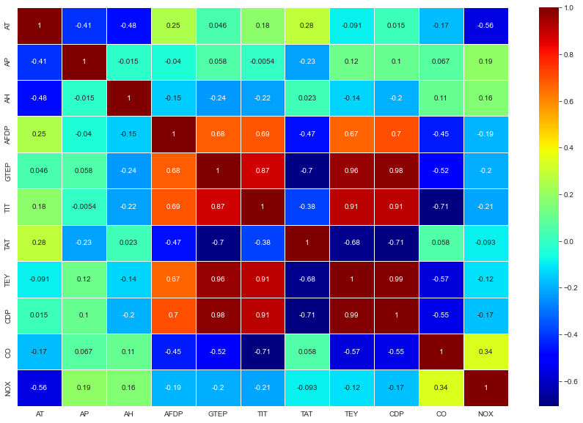
MULTIVARIATE ANALYSIS : Heat-Map

Slide 14
FEATURE IMPORTANCE IN DATASET
As per Univariate and Bivariate analysis CDP, GTEP, TIT, TAT, AFDP, CO these variable are very important to our prediction
In these variable there are many outliers which is directly impact our performance measure
Values of these features are highly correlated to our target columns, thus all values of features are required to get best accuracy, So we do not require to handle outliers
X is independent columns
X=df[[‘CDP’, ‘GTEP’, ’TIT’, ‘TAT’, ‘AFDP’, ‘CO’],axis=1]
y is Dependent columns(Traget columns)
y = df[['TEY']]

Slide 15
STANDARDIZATION USING STANDARD SCALER
For each feature, the Standard Scaler scales the values such that the mean is 0 and the standard deviation is 1(or the variance)
x_scaled=x-mean/std_dev
Standard Scaler assumes that the distribution of the variable is normal
Thus, in case, the variables are not normally distributed, we either choose a different scaler or first, convert the variables to a normal distribution and then apply this scaler

Slide 16
MACHINE LEARNING ALGORITHMS
SIMPLE REGRESSION 7. BAGGING
2. MULTIPLE REGRESSION 8. PASTING
3. DECISION TREE REGRESSION 9. ADABOOST
4. RANDOM FOREST REGREESION 10. GRADIENT BOOST
5. SUPPORT VECTOR REGRESSION 11. XGBOOST
6. K NEAREST NEIGHBOUR

Slide 17
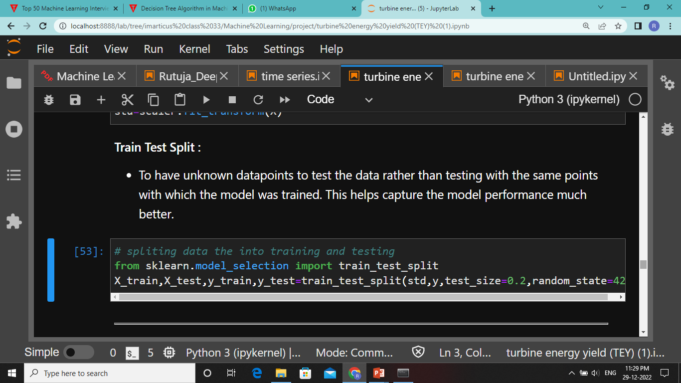
TRAIN TEST SPLIT

Slide 18
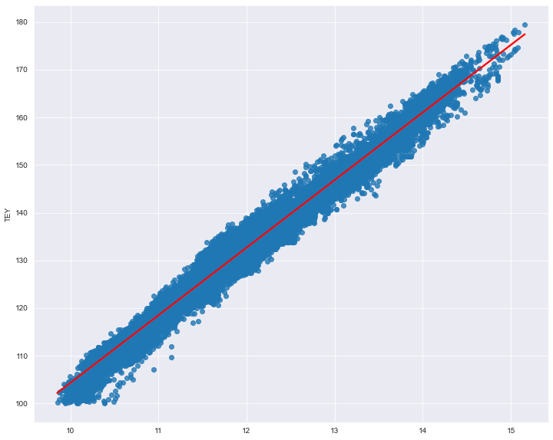
SIMPLE REGRESSION
This Simple Linear Regression Model is applied between input variable CDP (Compressor discharge pressure) & target variable TEY (Turbine Energy Yield)
PERFORMANCE
Train Result: r2_score: 0.9778
Test Result: r2_score: 0.9771
After cross validation
Training r2_score: 0.9778
Testing r2_score: 0.9771
Best Fit Line for CDP & TEY

Slide 19
MULTIPLE REGRESSION​
In Multiple Regression we use more than on independent variables are used to predict the value of dependent variable.
Independent Variables : 'CDP', 'GTEP','TIT', 'TAT', 'AFDP', 'CO', 'AT'.
Dependent variable: ’TEY’
PERFORMANCE
Train Result: r2_score: 0.995
Test Result: r2_score: 0.995
After cross validation
Training r2_score: 0.995
Testing r2_score: 0.995

Slide 20
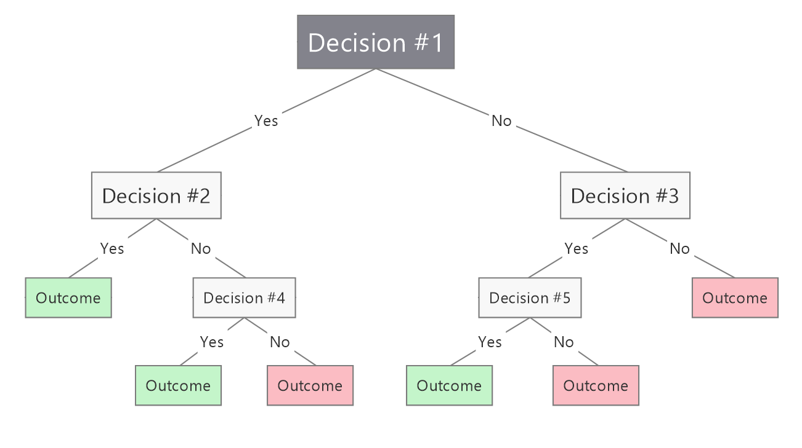
DECISION TREE REGRESSION​​
Decision Trees a tree-structured classifier, where internal nodes represent the features of a dataset, branches represent the decision rules and each leaf node represents the outcome.
PARAMETER USED:
DTR = DecisionTreeRegressor(max_depth=2)
PERFORMANCE
Train Result: r2_score: 0.9362
Test Result: r2_score: 0.9317
After cross validation
Training r2_score: 0.9357
Testing r2_score: 0.9317

Slide 21
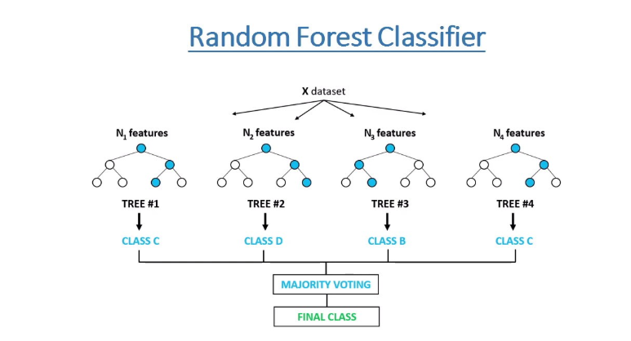
RANDOM FOREST REGRESSION
Random Forest contains a number of decision trees on various subsets and takes prediction from each tree and based on the majority votes of predictions it predicts the final output.
PARAMETER USED:
RFR = RandomForestRegressor(n_estimators=100)
PERFORMANCE
Train Result: r2_score: 0.999
Test Result: r2_score: 0.998
After cross validation
Training r2_score: 0.998
Testing r2_score: 0.987

Slide 22
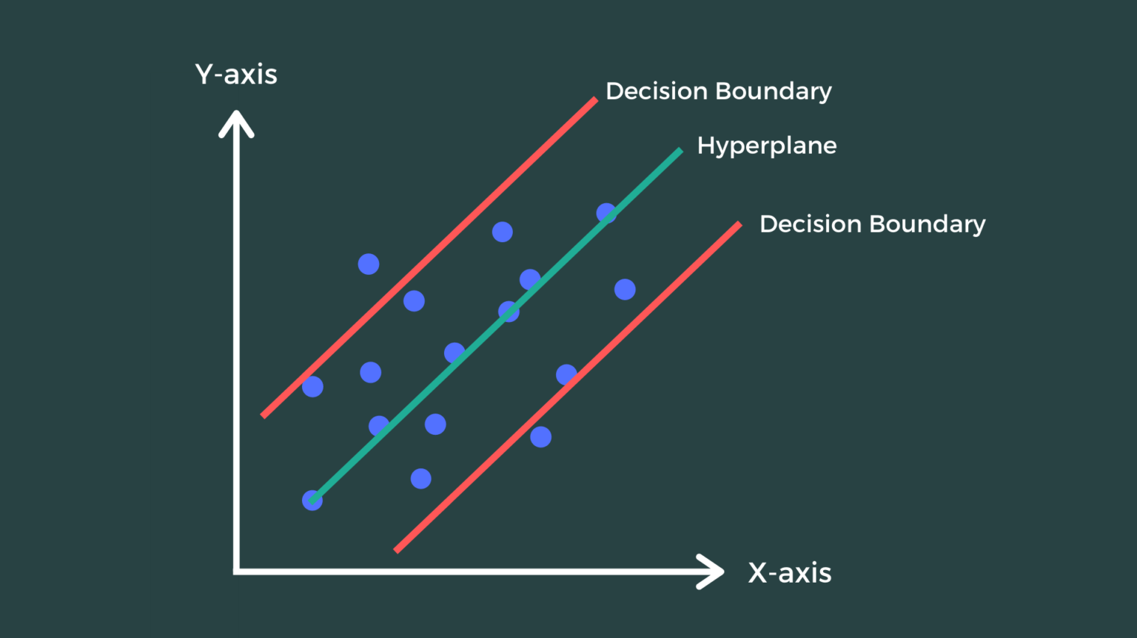
SUPPORT VECTOR REGRESSION
Support Vector Machine is a supervised learning algorithm which can be used for regression as well as classification problems.
The main goal of SVR is to consider the maximum datapoints within the boundary lines and the hyperplane (best-fit line) must contain a maximum number of datapoints.
PERFORMANCE
Train Result: r2_score: 0.995
Test Result: r2_score: 0.995
After cross validation
Training r2_score: 0.995
Testing r2_score: 0.989

Slide 23
K NEAREST NEIGHBOUR
K-NN algorithm assumes the similarity between the new case/data and available cases and put the new case into the category that is most similar to the available categories.
PERFORMANCE
Train Result: r2_score: 0.986
Test Result: r2_score: 0.981
After cross validation
Training r2_score: 0.982
Testing r2_score: 0.981

Slide 24
BAGGING
Bagging, also known as bootstrap aggregation, is the ensemble learning method that is commonly used to reduce variance within a noisy dataset.
PARAMETERS USED :
bag_reg_Bag = BaggingRegressor(DecisionTreeRegressor(),n_estimators=500,bootstrap=True,
random_state=42)
PERFORMANCE
Train Result: r2_score: 0.999
Test Result: r2_score: 0.998
After cross validation
Training r2_score: 0.998
Testing r2_score: 0.997

Slide 25
PASTING
Pasting creates a dataset by sampling the training set without replacement.
PARAMETERS USED :
bag_reg_past = BaggingRegressor(DecisionTreeRegressor(),n_estimators=500,bootstrap=False,
random_state=42)
PERFORMANCE
Train Result: r2_score: 0.999
Test Result: r2_score: 0.998
After cross validation
Training r2_score: 0.998
Testing r2_score: 0.997

Slide 26
ADABOOST
Adoboost is a very popular boosting technique that combines multiple “weak classifiers” into a single “strong classifier”.
PARAMETERS USED :
Adaboost = AdaBoostRegressor(random_state=42)
PERFORMANCE
Train Result: r2_score: 0.984
Test Result: r2_score: 0.983
After cross validation
Training r2_score: 0.985
Testing r2_score: 0.983

Slide 27
GRADIENT BOOSTING
Gradient Boost helps us to get a predictive model in form of an ensemble of weak prediction models such as decision trees. Whenever a decision tree performs as a weak learner then the resulting algorithm is called gradient-boosted trees.
PARAMETERS USED:
grad_reg = GradientBoostingRegressor(random_state=40,learning_rate=0.1)
PERFORMANCE
Train Result: r2_score: 0.996
Test Result: r2_score: 0.996
After cross validation
Training r2_score: 0.996
Testing r2_score: 0.996

Slide 28
XGBOOST
XGBOOST is the latest version of gradient boosting which also works very similar to Gradient Boost.
PARAMETERS USED:
xgb_reg = XGBRegressor(random_state=42,learning_rate=0.1)
PERFORMANCE
Train Result: r2_score: 0.998
Test Result: r2_score: 0.997
After cross validation
Training r2_score: 0.997
Testing r2_score: 0.997

Slide 29
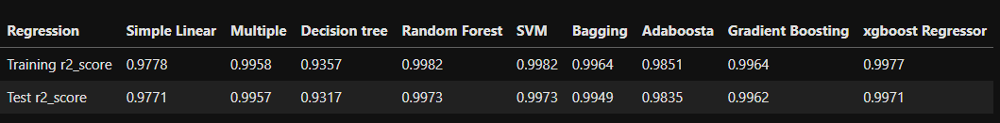
REPORT

Slide 30
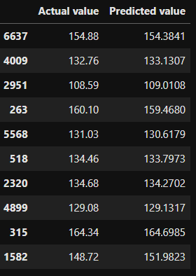
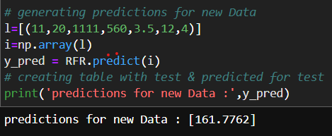
PREDICTING TARGET USING
ORIGINAL & NEW INPUTS

Slide 31
CONCLUSION
There is a relationship between the process, ambient variables 'CDP', 'GTEP','TIT', 'TAT', 'AFDP', 'CO', 'AT' and Turbine Energy Yield (TEY) also TEY can be predicted using these variables
After Comparing the r2_score of all models, Random Forest is the best among the all Regression models

Slide 32
THANK YOU!

